Slide 1
Task 2
Predicting customer buying behaviour

Slide 2

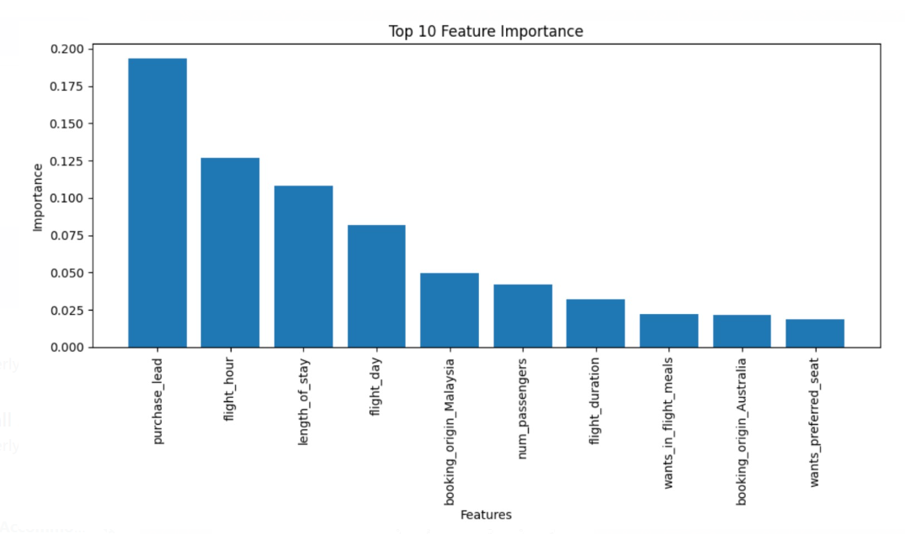
Insights
Evaluation metrics of Random Forest
Feature Importance Plot
The data set was prepared by removing a new feature and dividing the already-existing column "Route" into the columns "Origin" and "Destination.“
We trained a Random Forest classifier on our data to produce evaluation metrics.
Extracted and visualized the top 10 significant features that influenced classification the most.

